Slide 1
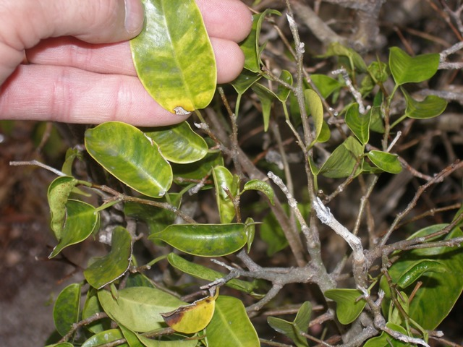
Palm Beach County, Florida
Whitefly Task Force
Bill Schall
Palm Beach County Extension
561.233.1725
bschall@pbcgov.org
Photo: UF Schall

Slide 2
Palm Beach Whitefly Taskforce
Precipitated by Bemisia tabaci outbreak on PB Island in late 2011 that was not responding to insecticide Management – suspected Q biotype
Photo: UF Schall

Slide 3
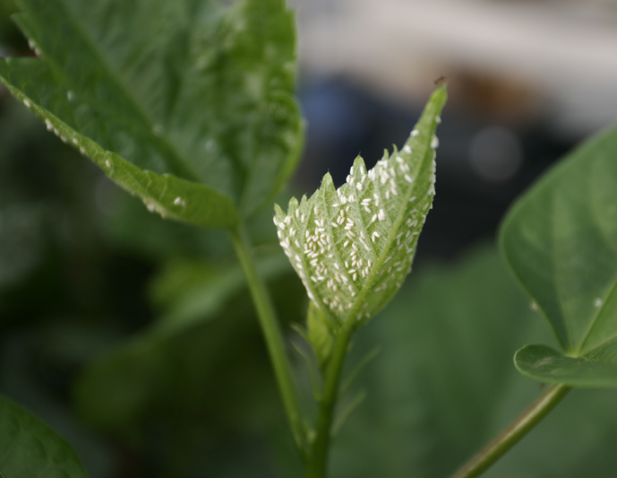
Photo: UF Osborne

Slide 4
Palm Beach Whitefly Taskforce
Also correlated to a particularly bad Ficus Whitefly - Singhiella simplex issue and now Rugose Spiraling Whitefly - Aleurodicus rugioperculatus and Bondar’s Nesting Whitefly - Paraleyrodes bondari
Photo: UF Schall

Slide 5
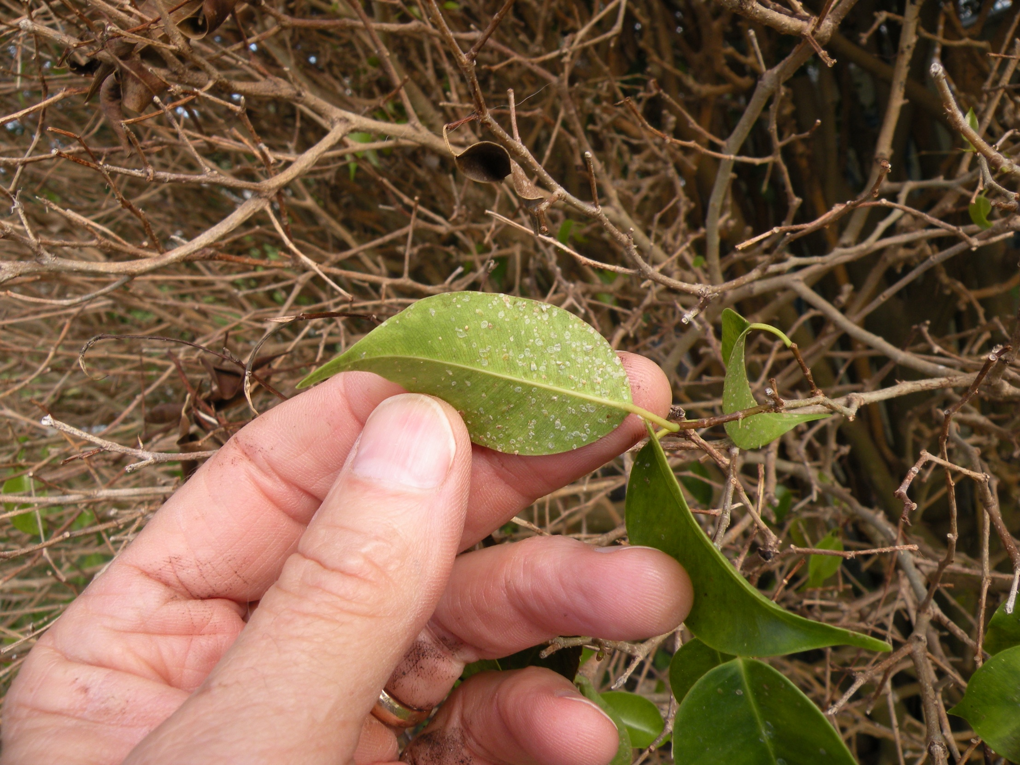
Photo: UF Schall

Slide 6
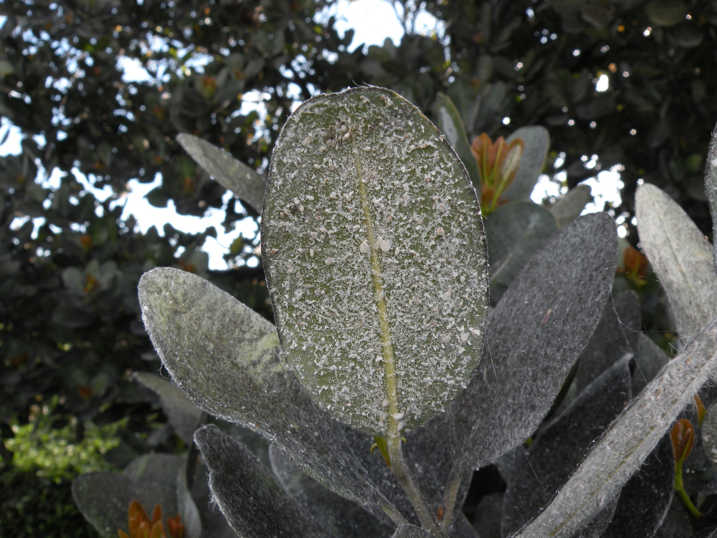
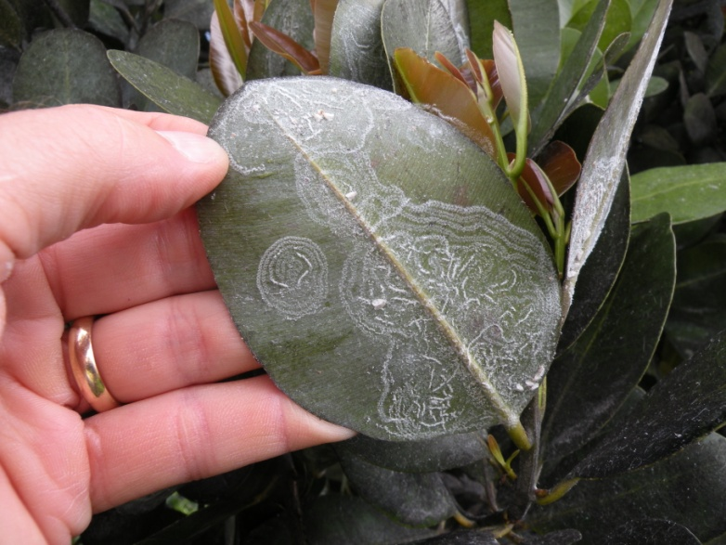
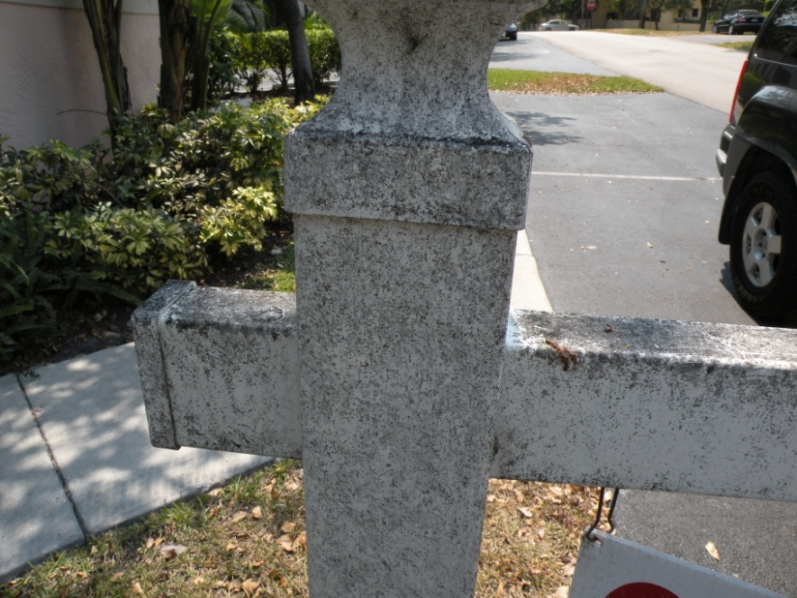
Photos: UF Schall

Slide 7
Palm Beach Whitefly Taskforce
To address invasive whitefly issue in Palm Beach
Comprised of 25 UF research and extension, PCOs, consultants, USDA, FDACS, Palm Beach Garden Club, Town of Palm Beach officials & media
Lance Osborne, PhD & Catharine Mannion, PhD key
Provide correct information & counterpoint to incorrect circulating misinformation
Provide practice with a framework to address potential future invasive species that get out of hand
Photo: UF Schall

Slide 8
Palm Beach Whitefly Taskforce
What We Did
Series of workshops - For pros, 3 PB Town Meetings, organized with Garden Club - about 450 total attended these workshops
Websites & Blog http://pbcgov.com/coextension/horticulture/whitefly
Photo: UF Schall

Slide 9
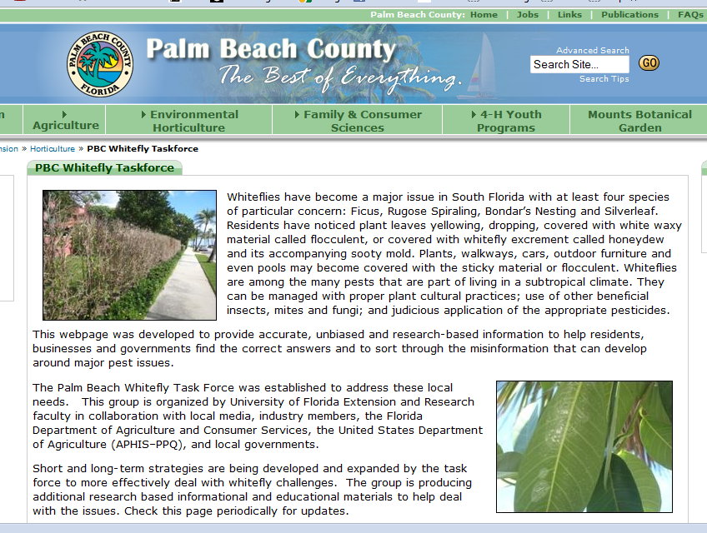

Slide 11
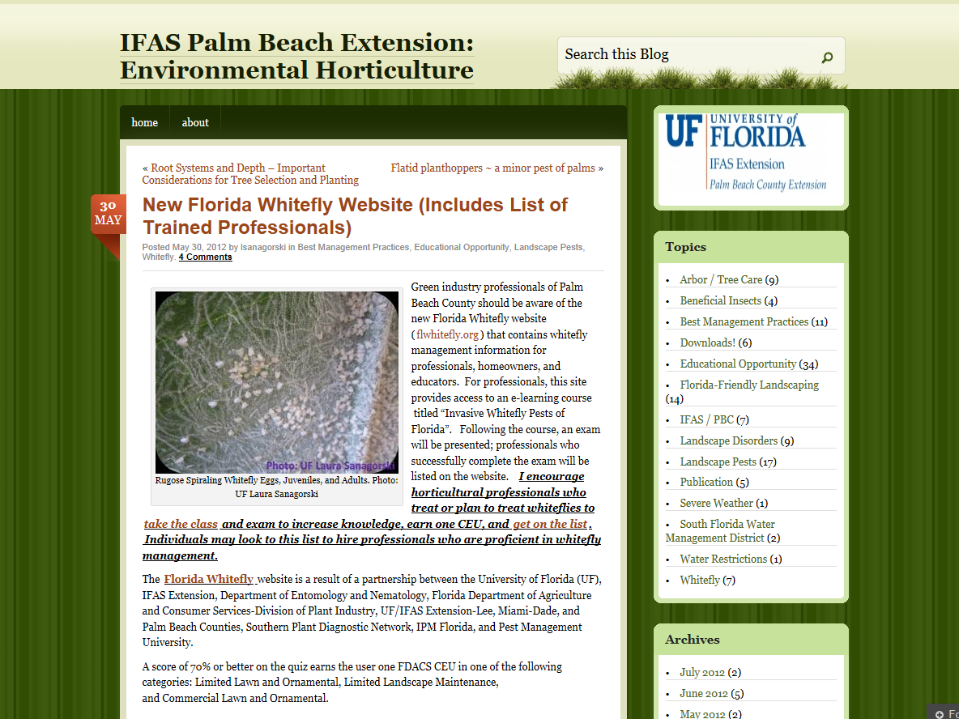

Slide 13
Palm Beach Whitefly Taskforce
What Else We Did
Newspaper releases & articles
Photo: UF Schall

Slide 14
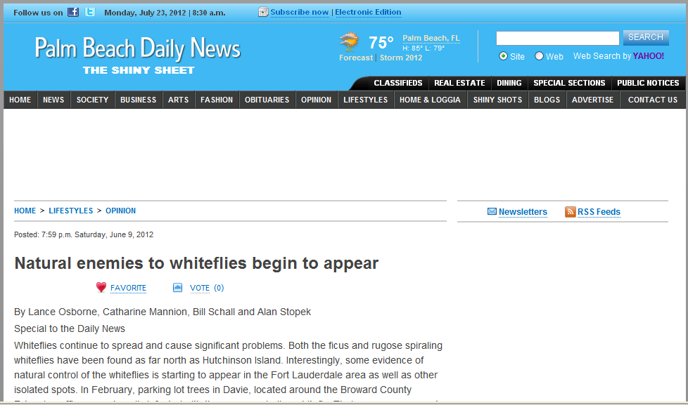

Slide 15
Palm Beach Whitefly Taskforce
What Else We Did
Beneficial releases Nephaspis oculatus, Swirskii mites, insect pathogens (PFR 97) and monitoring
Photo: UF Schall

Slide 16
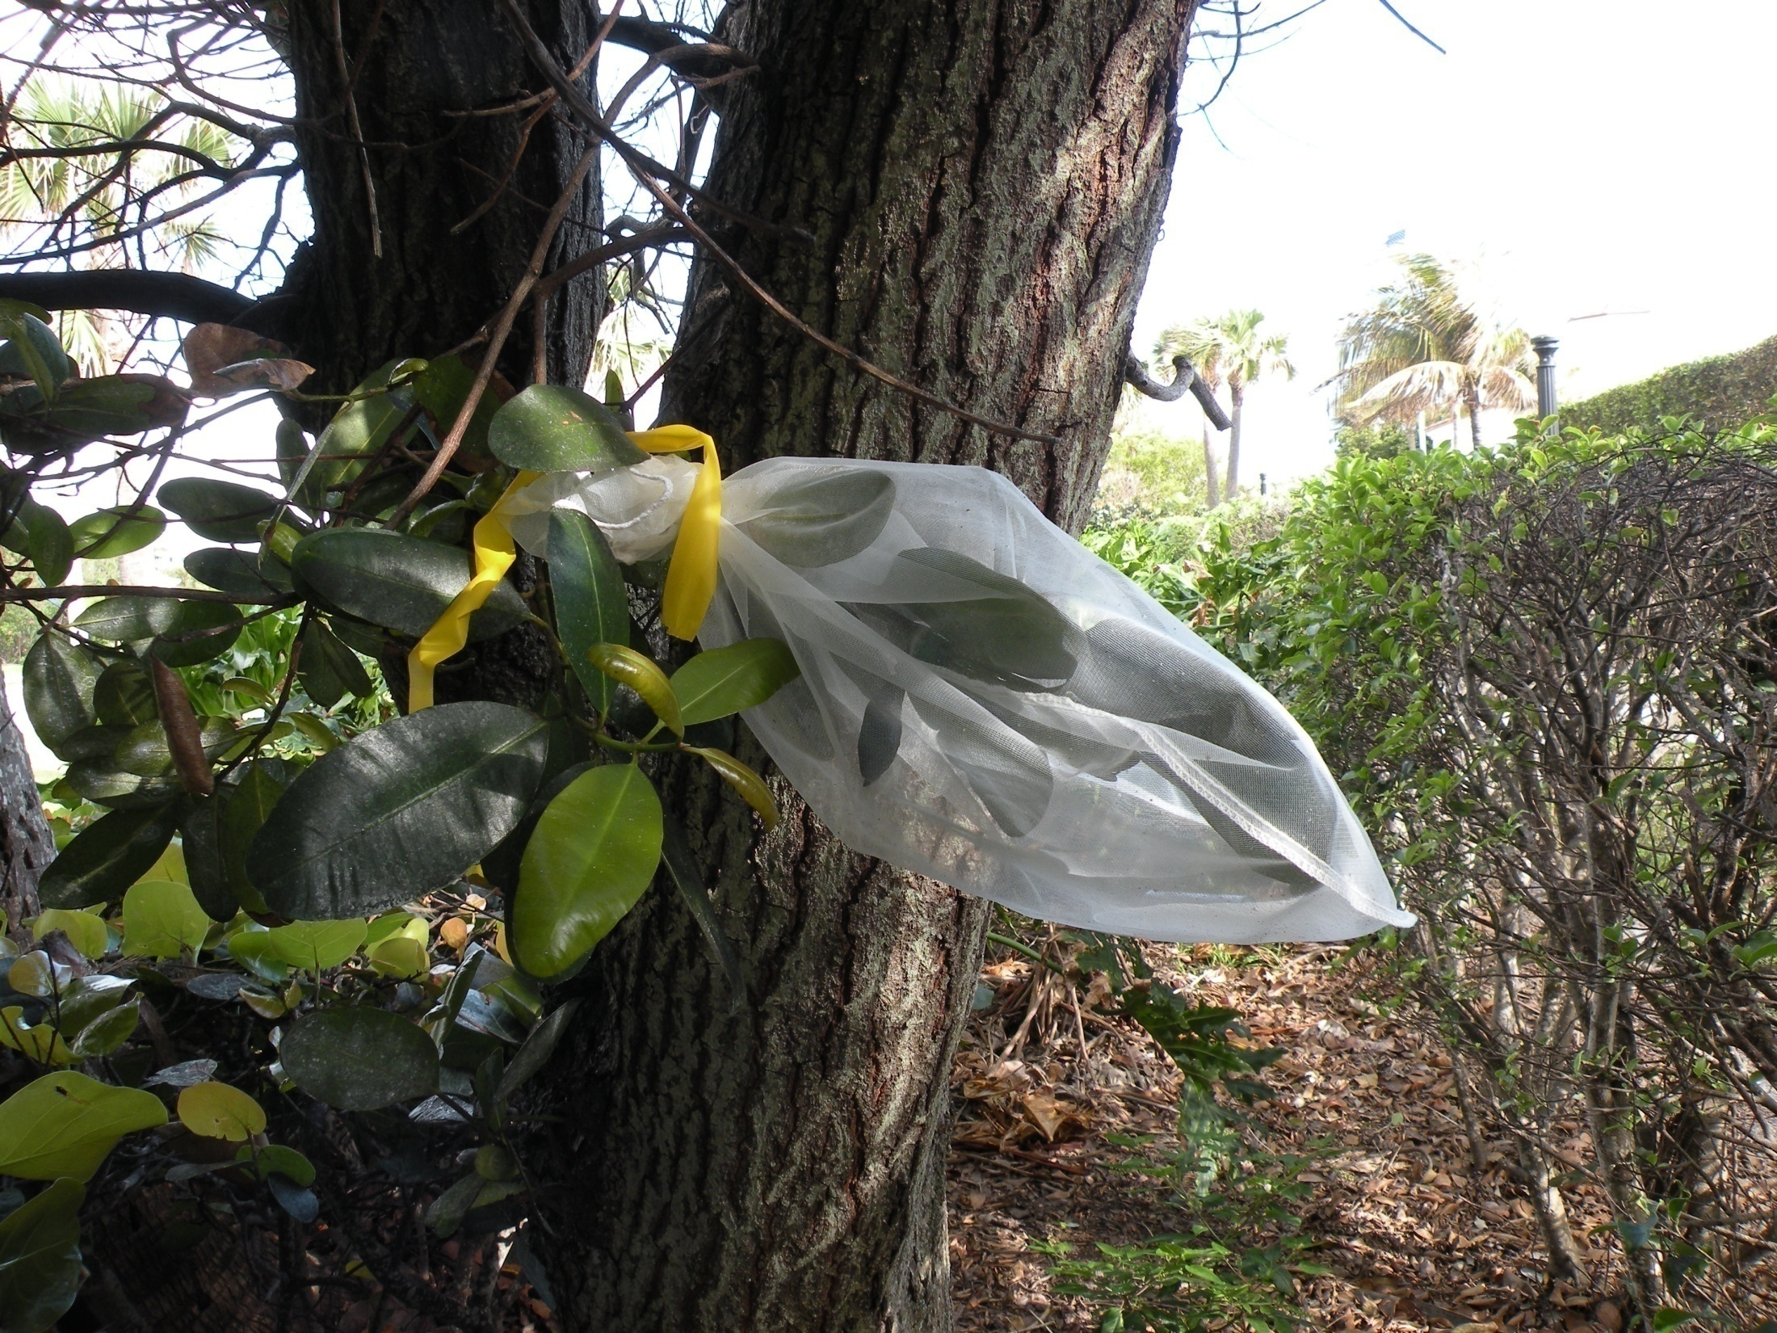
Photo: UF Schall

Slide 17
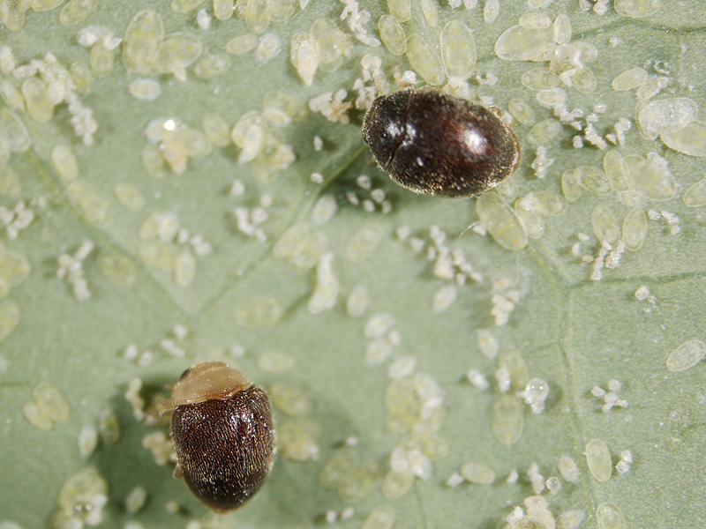
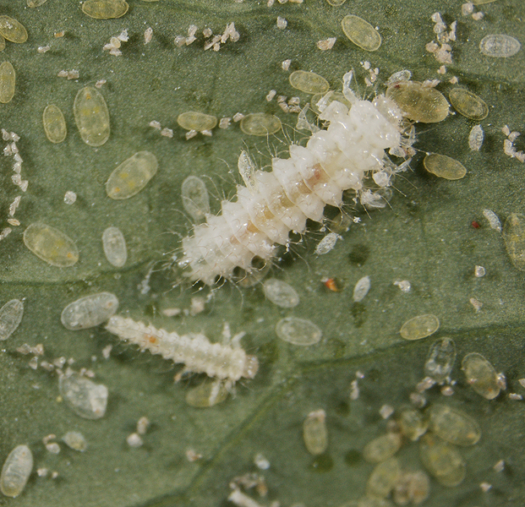
Photos: UF Osborne

Slide 18
Palm Beach Whitefly Taskforce
What We Did
Helped Town of Palm Beach modify what became their town ordinance to deal with whiteflies
About 3-5 calls or emails daily – still
Lots of site visits
Non-stop presentations to groups – particularly HOAs and citizen associations
Continue meet with taskforce to refine priorities & goals
Provides a nice core effort to link to the FDACS Whitefly Task Force
Continue to try and help other extension agents that are just now dealing with, or will be soon
Photo: UF Schall

Slide 19
Palm Beach Whitefly Taskforce
Key to pulling it all together
Tapped into activist fervor and real fear by Town of Palm Beach over the issue – and USDA immediate response to suspected resistant silverleaf whitefly
Pushed ourselves to work with everyone who had an interest, no matter what their bias or difficulty in working with them – takes time – also, don’t forget about your own extension office key staff
Were able to position ourselves as the information source
Entomology Specialists Lance Osborne and Catharine Mannion very important early on in helping with the technical aspects – especially how to deal with the whitefly on an entire municipality basis via ordinance.

Slide 20
Questions?
Bill Schall
Palm Beach Extension
561.233.1725
bschall@pbcgov.org
Palm Beach County
E X T E N S I O N

